Slide 1
Physics 201
Winter 2013
Equilibrium and torque

Slide 2
Two roads diverged in a yellow wood…
Winter 2013
We have completed our introduction to the laws of force for particle-like systems
We now have a choice:
The book chooses energy, but we will try torque
Energy
Torque
Torque

Slide 3
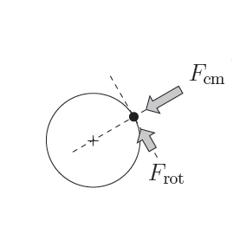
In general, a force has two significant components
Winter 2013
Remember me?
This will make the puck move
Force in line with the center of mass – leads to acceleration
Force perpendicular to the center of mass – leads to rotation
This will make the puck spin

Slide 4
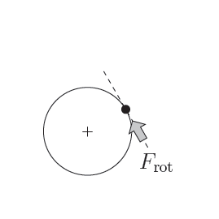
Torque is about leverage
Winter 2013
Force perpendicular to the center of mass – leads to rotation
This will make the puck spin

Slide 5
The study of leverage goes back to Archimedes
Winter 2013

Slide 6
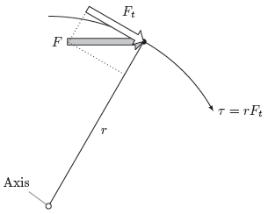
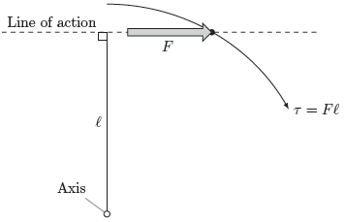
Two compatible ways to calculate torque
Winter 2013
Tangential component
Lever arm

Slide 7



Equilibrium is balance along every degree of freedom
Winter 2013
Remember me?
In general, a rigid object has six degrees of freedom, but we will only consider fixed rotation
For fixed rotation there are three equations of equilibrium:
When in equilibrium, where is the axis of rotation?
Answer: anywhere…
Show me

Slide 8
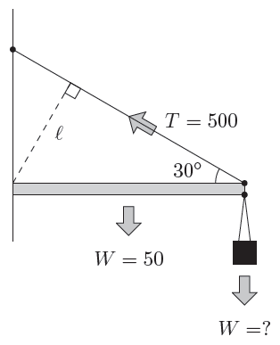
A typical problem…
Winter 2013
Show me

